Slide 1
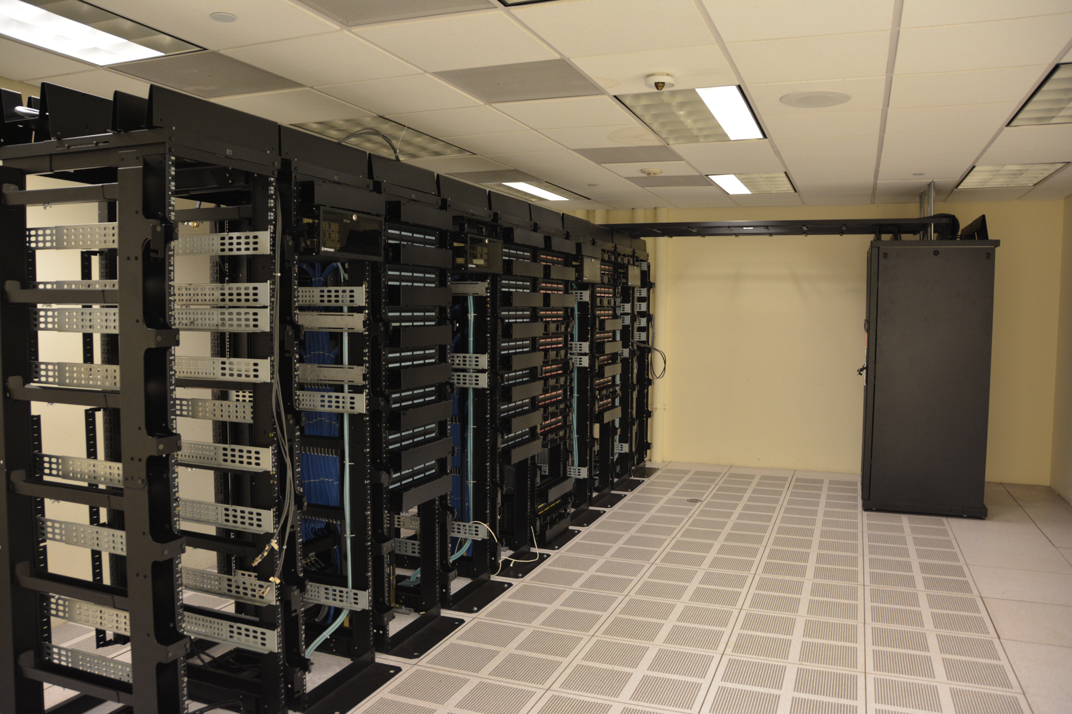
FINAL PROJECT/ STUDENT ENGAGEMENT GUIDE
Northline Compute
Data Center Internal Pentest
A cooling-control assessment
in Lake Junction, Wisconsin
Northline is fictional. Photograph shows a real data center.
COSC 3840/6840 · Final Project
01

Slide 2
THE CLIENT BRIEF
Facilities has hired your team
1
The business
2
The client’s concern
Northline hosts checkout, payment and inventory services for regional retailers. Row A carries checkout workers and inventory API nodes.
A maintenance workstation sits on both IT and OT. Facilities wants to know whether that access path exposes the cooling controls.
3
Your starting point
4
Your assignment
You are given access into the IT network as your starting point. You task is to discover the maintenance portal, recover access and document what becomes reachable.
Find 6 flags, make one planned control change, capture the thermal effect and document evidence and fixes.
COSC 3840/6840 · Final Project
02

Slide 3
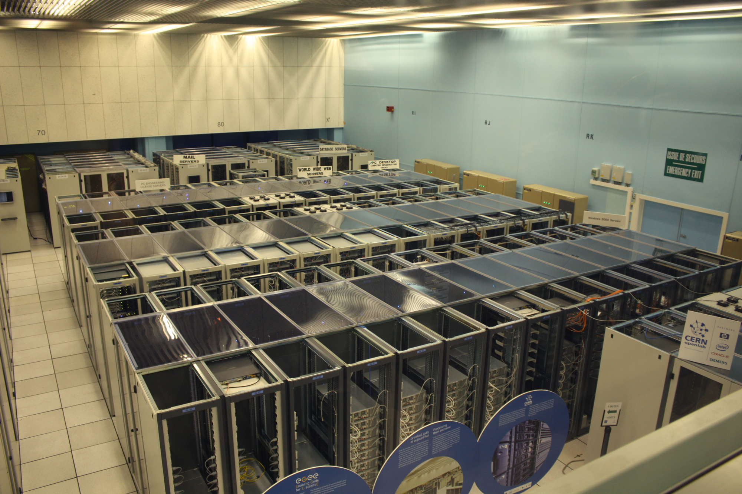
THE PHYSICAL PROCESS
Why servers need a cold aisle
1
Servers produce heat
Electrical power becomes heat as workloads run. Racks group servers so power, networking and cooling can be managed.
2
Keep supply air separate
The transparent roofs cover contained aisles. Containment helps keep cold supply air separate from hot exhaust.
In Row A, the fan moves cooling air toward server inlets. Losing airflow raises the inlet temperature.
COSC 3840/6840 · Final Project
03

Slide 4
WHAT IS AT STAKE
Follow the consequence to the customer
Fan slows
Airflow falls
Inlet heats
Services degrade
1
Possible operational effect
2
A modeled business exposure
Sustained heat can lead to throttling or shutdown. Checkout may queue or fail. Inventory updates may lag while operators fail over workloads.
1,200 attempts/hour × 0.25 hour = 300 attempts.
20% abandoned × $75/order = $4,500 in orders at risk.
COSC 3840/6840 · Final Project
04

Slide 5
SCENARIO
Rules of engagement
Test only the containers and internal networks in your assigned lab instance.
One planned process-impact demonstration. Record the baseline and suggest mitigation strategies.
Capture the result documented step by step.
Real equipment, campus networks, other students’ instances and public targets are outside scope. Public vendor documentation may be read to help your investigation.
COSC 3840/6840 · Final Project
05

Slide 6
ASSIGNMENT
What you will deliver
File
What we will grade
ot_assess.py (or one equivalently documented script)
Reusable, read-only automation of one substantial OT step.
README.md
Runtime and versions, dependencies and installation commands, execution location, exact example command, arguments, expected output, and troubleshooting.
report.pdf
5–7 pages of main text. Examples of what it may contain include scope, topology, evidence for six stages, baseline/impact/recovery, root cause, remediation, evidence appendices.
COSC 3840/6840 · Final Project
06

Slide 7
GRADING
100 points across four deliverables
Assessment execution
65
Automation
15
Technical report
20
COSC 3840/6840 · Final Project
09

Slide 8
GRADING / PERFORMANCE LEVELS
Rubric · Access and identification
Category
Weak
Good
Perfect
Web access
8 points
2 points
Identify the portal host and one HTTP service; show a normal document request.
5 points
Reproduce one restricted-file disclosure with request and response evidence.
8 points
Also capture the flag and explain the path boundary crossed and sensitive content exposed.
System access
8 points
2 points
Identify the relevant hash format and record where it was recovered.
5 points
Show an offline audit command and successful access with evidence.
8 points
Also capture the foothold flag and explain why the OT network is now reachable.
Device identity
8 points
2 points
Identify the OT endpoint and open services.
5 points
Show an identity request and correctly identify vendor and model.
8 points
Capture the identity flag.
Award the highest fully demonstrated level. Missing or unverifiable work earns 0. Higher levels include the evidence required by lower levels.
COSC 3840/6840 · Final Project
10

Slide 9
GRADING / PERFORMANCE LEVELS
Rubric · Discovery and process impact
Category
Weak
Good
Perfect
Process discovery
8 points
2 points
Capture a relevant holding-register block with address and word count.
5 points
Correctly decode its text and recover the asset tag and flag.
8 points
Distinguish one vendor parameter from one site mapping, with sources.
Historian
13 points
4 points
Reach the historian through a documented SSH forward and identify the lookup.
9 points
Show paired true/false evidence and a reproducible targeted extraction command.
13 points
Also recover the flag and engineering note; explain one control implication using its contents.
Impact + recovery
20 points
6 points
Record baseline fan, airflow, temperature and control settings; give a justified test plan.
14 points
Also show one control write, critical HMI state and flag; recovery evidence may be incomplete.
20 points
Also show restoration commands and normal-state evidence; explain the time-ordered thermal response.
Award the highest fully demonstrated level. Missing or unverifiable work earns 0. Higher levels include the evidence required by lower levels.
COSC 3840/6840 · Final Project
11

Slide 10
GRADING / PERFORMANCE LEVELS
Rubric · Automation, report and briefing
Category
Weak
Good
Perfect
Automation
15 points
5 points
One meaningful read-only task is attempted. Invocation is documented, but execution or results are incomplete.
10 points
Script accepts an input argument, runs from README instructions, and gives correct labeled output for one valid case.
15 points
Also handles one invalid case with an actionable error. README gives dependencies, execution location and commands to reproduce both cases.
Technical report
20 points
5 points
Some findings and traceable evidence, but major sections or stages are missing.
10 points
Scope, topology, six-stage evidence index, method, root cause and recovery are present; some claims or fixes lack support.
20 points
5–7 pages of main text; all claims link to numbered evidence. Include at least 3 prioritized fixes tied to demonstrated failures.
Award the highest fully demonstrated level. Missing or unverifiable work earns 0. Higher levels include the evidence required by lower levels.
COSC 3840/6840 · Final Project
12

Slide 11
LAB SETUP
First run on your computer
docker version
docker compose version
cd env
docker compose up -d --build
docker compose ps
# access your starting point
docker exec -it toolbox bash
1. Install and Open Docker Desktop in Linux-container mode on Windows or macOS, or start Docker Engine with Compose on Linux.
2. Copy or extract the course bundle to a local folder. Open a terminal in the lab root.
3. Check Docker and Compose, then build and start the stack.
4. Confirm toolbox, ews, vfd, hmi and historian are running.
5. Open http://localhost:8080 and leave it visible.
COSC 3840/6840 · Final Project
14

Slide 12
LAB SETUP
Equipment and access
What you have
Role
Personal computer, Docker and Compose
Runs the five-container lab. Your browser displays the HMI and opens public manuals.
Toolbox (The machine you are given access as your starting point)
Starting Linux host on IT. Use shell tools, Nmap, curl, John, SSH and sqlmap.
Engineering workstation (EWS)
Maintenance portal and SSH host with interfaces in IT and OT. Runs mbpoll and the PyModbus console.
Schneider Altivar Process ATV630 simulator
The VFD controlling the virtual fan. It exposes Modbus/TCP.
Human-machine interface (HMI)
Operator screen for fan, airflow, inlet temperature and alarm state.
Process historian
OT-side SQLite-backed web application for trend lookup and engineering data.
COSC 3840/6840 · Final Project
15

Slide 13
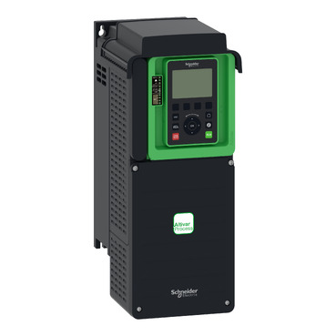
EQUIPMENT / SCHNEIDER ELECTRIC
The physical ATV630 behind the simulator
1
Altivar Process ATV630
The lab identifies as ATV630D11N4, an 11 kW / 15 hp drive for a 380–480 V supply. This manufacturer photo shows the ATV630 product family.
2
What students interact with
The real drive has a local keypad and display. In this lab, the EWS sends Modbus/TCP requests to a software simulator of its control interface.
Photo © Schneider Electric · official product image
COSC 3840/6840 · Final Project
16

Slide 14
EQUIPMENT / VARIABLE-FREQUENCY DRIVE
Meet the Schneider Altivar ATV630
The lab emulates ATV630D11N4. In the Docker images you can read the device identity to confirm vendor and model.
CMD
Control state
ATV630
Motor controller
Motor
turns fan
Airflow
LFR
Requested Hz
1
Reference and output
2
Command and status
LFR is the requested frequency. RFR is the reported output frequency. The baseline is 500 counts = 50.0 Hz.
CMD tells the drive what to do. ETA reports state bits.
COSC 3840/6840 · Final Project
17

Slide 15
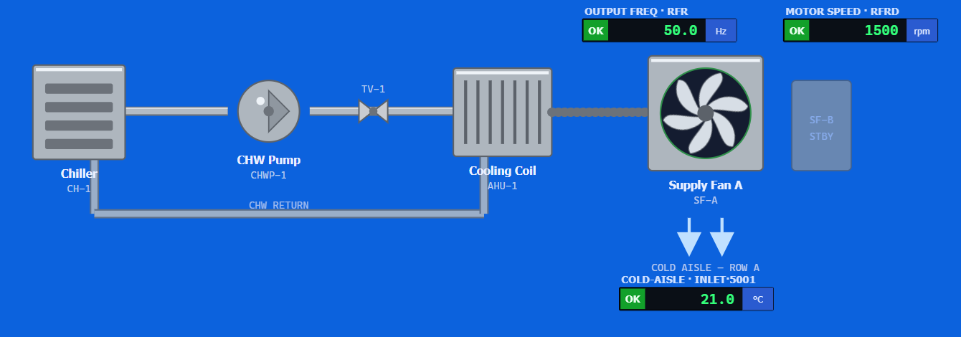
HMI / HUMAN-MACHINE INTERFACE
The operator sees the cooling process
1
Follow the equipment
2
Read the live output
3
Watch the consequence
Chiller and pump feed the coil. Supply Fan A moves air toward the Row A cold aisle.
RFR is 50.0 Hz and the inlet reads 21.0 °C in this normal-state capture.
The assessment targets the drive and fan. The temperature indication shows the downstream effect.
COSC 3840/6840 · Final Project
18

Slide 16
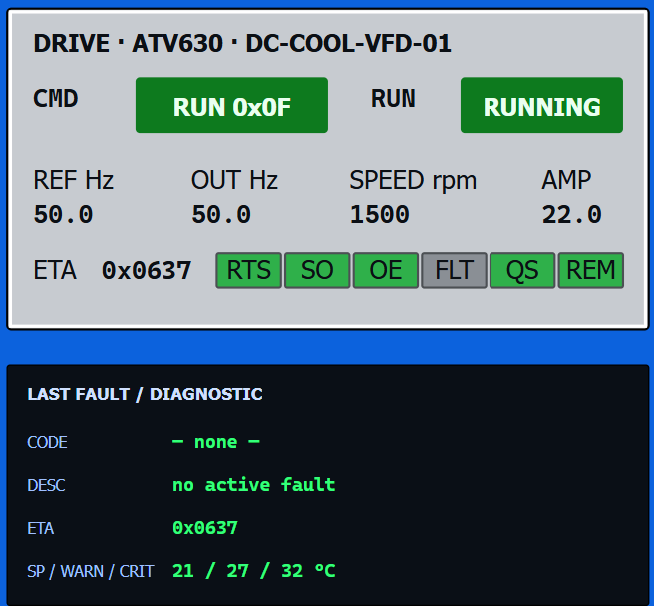
HMI / ACTUAL LAB CAPTURE
Translate the faceplate into registers
1
CMD and ETA
CMD = RUN 0x0F. ETA = 0x0637. Compare the command with the state indicators beneath it.
2
Reference and output
REF Hz and OUT Hz both read 50.0. These correspond to LFR 8502 and RFR 3202.
3
Thermal thresholds
The diagnostic panel shows SP / WARN / CRIT as 21 / 27 / 32 °C. Capture the alarm when critical is crossed.
COSC 3840/6840 · Final Project
19

Slide 17
WALKTHROUGH
The six flags
Stage
Flag objective
Evidence
1 · Web access
Obtain the portal exposure flag.
Request and response showing restricted lab content.
2 · System access
Obtain the EWS foothold flag.
Successful access, identity of host/user and flag provenance.
3 · Device identification
Obtain the Modbus identity flag.
Identity request and decoded vendor, model and relevant object.
4 · Process discovery
Obtain the process/nameplate flag.
Raw register read, ASCII decode and asset context.
5 · Process-history extraction
Obtain the historian flag.
Tunnel, blind-injection evidence and relevant extracted engineering note.
6 · Process impact
Obtain the thermal-fault flag.
Baseline, single control action, HMI critical event and verified recovery.
COSC 3840/6840 · Final Project
23

Slide 18
WALKTHROUGH
OT discovery and protocols
Protocol
What it does here
HTTP
Portal documents, historian queries and the HMI view. Look for the application’s role as well as its port.
SSH · TCP 22
EWS login and a tunnel from the toolbox to an OT web service.
Modbus/TCP · TCP 502
Device identity, process reads and drive commands.
SQL
The historian application queries SQLite behind its HTTP interface.
COSC 3840/6840 · Final Project
26

Slide 19
WALKTHROUGH
Modbus/TCP and device identity
# EWS shell
pymodbus.console tcp --host DRIVE_IP --port 502
# At the PyModbus prompt
client.read_device_information read_code=3
The EWS acts as client. The drive answers on TCP 502 with unit ID 1.
Use function 43, MEI 14, to request device identity.
Compare basic and extended identification. Record vendor, product and model fields.
Use the discovered model to find the vendor’s communication parameter reference.
COSC 3840/6840 · Final Project
27

Slide 20
WALKTHROUGH
How to read a register map
1. Identify the register table and the parameter’s logic address.
2. Check read/write permissions, signedness, scale and units.
3. Check whether the tool adds an address offset.
4. Decode the word according to its meaning: scaled integer, status bits or text bytes.
5. Corroborate the interpretation with the HMI or site documentation.
COSC 3840/6840 · Final Project
28

Slide 21
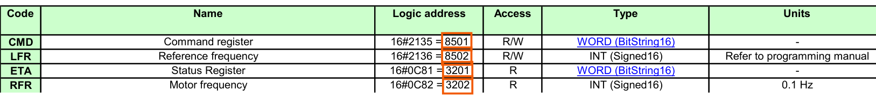
SOURCE / EAV64332 v4.6
Read the actual Schneider parameter sheet
1
Choose the logic address
2
Check access and type
3
Check units
CMD 8501 and LFR 8502 are the command/reference pair. ETA 3201 and RFR 3202 report status/output.
R/W permits a write. R denotes read-only. WORD is a bitfield here; INT is a signed 16-bit value.
RFR is 0.1 Hz per count. LFR points to the programming manual; this simulator also uses 0.1 Hz/count.
Original worksheet, Parameters rows 3 / 6 / 10 / 21 · click to download Schneider EAV64332 v4.6
COSC 3840/6840 · Final Project
29

Slide 22
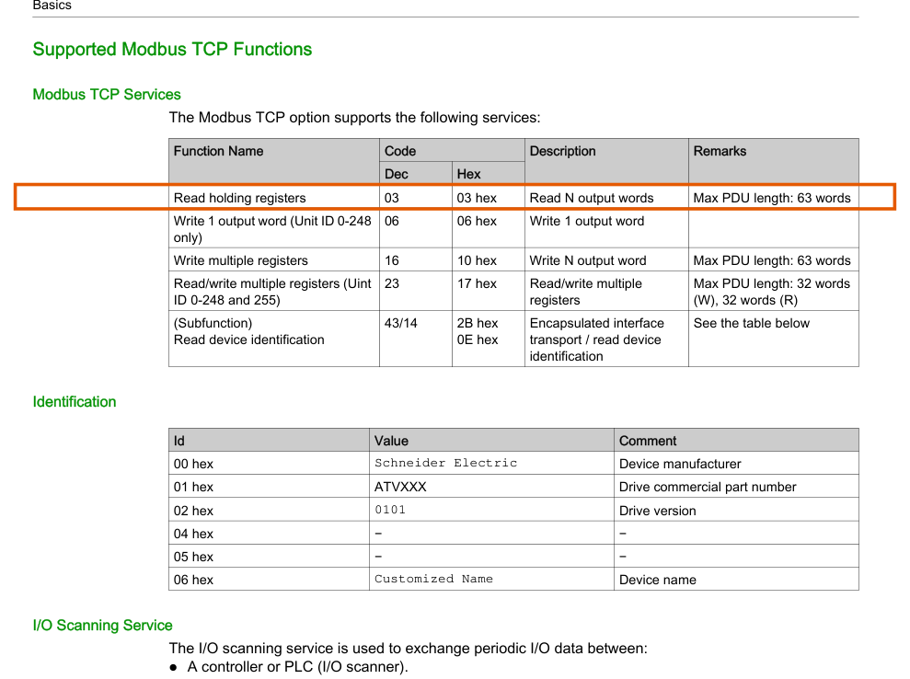
SCHNEIDER SOURCE
Read the Modbus function table
03 Read holding registers
06 Write one output word
16 Write multiple registers
43/14 Read device identity
Unit 1 selects the simulated drive. Start with reads from the EWS.
Open the exact Schneider PDF at page 26
COSC 3840/6840 · Final Project
30

Slide 23
REGISTER INTERPRETATION
A word has 16 bits and several meanings
1
Scaled measurement
2
State bitfield
3
Two text bytes
RFR = 500 decimal
500 × 0.1 Hz = 50.0 Hz
Use the scale and units from the map. Compare the result with the live output field.
ETA = 0x0238
0x0238 & 0x0008 = 8
Bit 3 is set, so the fault indication is active. Decode flags with masks, not scaling.
16706 = 0x4142
0x41 → A 0x42 → B
This site stores the high byte first. Join words in address order to recover the nameplate.
One raw integer can be a measurement, a collection of flags, or two characters. The meaning comes from the parameter definition and site mapping.
COSC 3840/6840 · Final Project
33

Slide 24
PROCESS HISTORY
What a historian stores
ASSET TAG
TIMESTAMP
MEASUREMENT
ENGINEERING NOTE
DC-COOL-VFD-01
When was it sampled?
Temperature, speed, state
How the site is configured
1
A record over time
2
This lab’s implementation
Operators investigate when a change began, which tag changed first and whether the process recovered. The asset tag connects records to the physical equipment.
The historian is an HTTP application backed by a seeded SQLite database. Its trend endpoint reveals whether samples exist. Engineering notes supply site-specific control context.
The HMI is the live operator view. The historian exercise uses stored records; its samples are seeded for the scenario.
COSC 3840/6840 · Final Project
37

Slide 25
WALKTHROUGH
Reaching the historian through SSH
# Toolbox shell 1. Keep this foreground SSH process open.
ssh -N -o ExitOnForwardFailure=yes -L 127.0.0.1:8000:HISTORIAN_IP:80 LAB_ACCOUNT@EWS_IT_IP
# Toolbox shell 2. Verify the forwarded app first.
curl -i 'http://127.0.0.1:8000/'
The listener is on the toolbox loopback address.
SSH carries the connection to the EWS. The EWS connects to the OT historian.
Close the foreground tunnel with Ctrl+C after collecting the evidence.
COSC 3840/6840 · Final Project
36

Slide 26
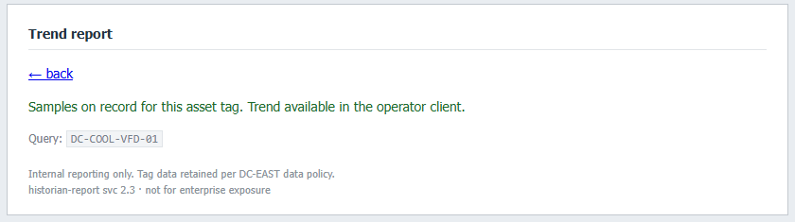
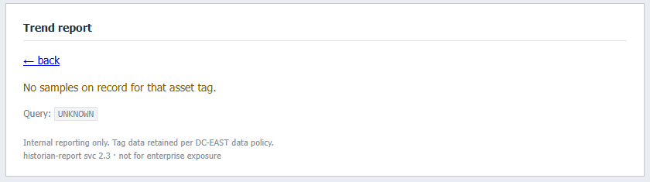
PROCESS HISTORY / ACTUAL LAB CAPTURES
The historian answers a question about an asset
1
Known asset
DC-COOL-VFD-01 returns “Samples on record.” The HTTP interface reports existence, while the records live in SQLite.
2
Unknown asset
A missing tag returns the empty state. Compare the response marker before designing a true/false injection test.
COSC 3840/6840 · Final Project
38

Slide 27
WALKTHROUGH
Blind SQL injection and engineering notes
# Toolbox shell, through the SSH tunnel
sqlmap -u 'http://127.0.0.1:8000/LOOKUP_PATH?PARAMETER=KNOWN_TAG' -p PARAMETER --dbms=SQLite --technique=B --batch --tables
# After identifying the relevant table, use --dump -T TABLE_NAME.
Identify the historian lookup parameter. Compare a known valid tag with a known miss.
Use matched true/false tests to check whether you can change the result deterministically.
The page reveals whether samples exist. It does not return the queried rows.
Use sqlmap to infer the schema and extract only the engineering data required for the exercise.
Explain how the recovered note informs the control test.
COSC 3840/6840 · Final Project
39

Slide 28
WALKTHROUGH
Plan the control test
Record time, HMI state, temperature, fan output, airflow and the raw control settings needed for rollback.
Identify which parameter changes the fan and which monitoring values show the effect.
Cross-check address, access, scale and meaning against the vendor map and site handover.
Write down the exact test command and restoration commands before you act.
Keep the HMI and an evidence log visible.
COSC 3840/6840 · Final Project
41

Slide 29
EVIDENCE & REPORTING
Report structure and root cause
1. Executive summary — What starting access can lead to, the demonstrated consequence, and the most important fix.
2. Scope and method — Authorized targets, test sequence, tools and limitations.
3. Findings — Evidence, prerequisites, technical effect and operational impact for each stage.
4. Attack path — Show how the findings combine from portal to fan control.
5. Recovery and remediation — Show restoration and prioritize controls.
COSC 3840/6840 · Final Project
45

Slide 30
EVIDENCE & REPORTING
Troubleshooting and teardown
Symptom
First check
Docker command fails
Check Docker engine and Compose from the host terminal.
HMI unavailable
Check Compose status, port 8080 conflicts and HMI logs.
HMI shows lost drive communications
Check vfd startup and logs. Wait for normal telemetry before testing.
Modbus times out
Confirm EWS shell, address, TCP 502 and unit ID.
Words look shifted or garbled
Confirm -0, holding-register table, address, count and byte order.
Historian unavailable through forward
Check EWS reachability, local listener and curl from the toolbox (your starting point, the machine you are given access).
Temperature stays high
Check restored command state, frequency reference and measured output. Escalate if recovery stalls.
COSC 3840/6840 · Final Project
46

Slide 31
EVIDENCE & REPORTING
Capstone debrief
What changed when you gained the EWS foothold?
How did identity, register metadata and site notes each reduce uncertainty?
Which evidence shows that the write affected the cooling process?
Which control would break the chain earliest? Which would reduce impact after a foothold?
What did you do to leave the simulated process in a safe state?
COSC 3840/6840 · Final Project
47

